Slide 1
Project outline - Team 114
CS398 Design Review 1
Shonn, Kevin, Insung

Slide 2
INDEX
 | Part 1 – Planning
1 | Purpose and Usage
2 | Target Users and Major Features
 | Part 2 – Requirements
3 | User Interview
4 | Functional and Non-Functional Requirements
 | Part 3 – Analysis & Design
5 | Architectural Style
6 | UI/UX Design
7 | Design Patterns

Slide 3
Part 1 – Planning
1 | Purpose and Usage
2 | Target Users and Major Features

Slide 4
1. Purpose and Usage
The purpose of this application is to
keep track of events and schedules of school life
organize daily events by each classes
classes function as semi folder
The application is designed so that users can
grasp an overview of one’s weekly schedule
leave quick notes regarding certain class
leave a reminder for oneself regarding certain class

Slide 5
2. Target Users and Major Features
The application is targeted for students but anyone with regular weekly schedules can benefit from using this application.
The application provides:
Weekly calendar with lecture schedule of all courses on it
Capability to take notes under each courses
Capability to search notes via keywords
Capability to set alarm for specific notes at specific date and time

Slide 6
Part 2 – Requirements
3 | User Interview
4 | Functional and Non-Functional Requirements

Slide 7
3. User Interview
Experience with Note Taking Application
Used such application for:
Assignments
Course and lecture notes
Haven’t used such application because:
It does not want to invest time on learning how to use such applications
There are too many redundant functionalities
Calendar application serves all needs for taking notes
Preferred platform:
Smart phone
Tablet
PC

Slide 8
3. User Interview
Preferred features
To-do list
Checkbox
Allow attachment of pictures and screenshots
No handwriting – handwriting on phone never works
Shortcuts for creating notes
Tags on notes for filters
Order by time

Slide 9
4. Functional and Non-Functional Requirements
functional requirements
Notes
Create/Edit/Delete functionality
View with collection of notes
Search by keyword
Group by classes
Images attachment
Alarm
Calendar
Weekly calendar
Show Lecture schedule
Create quick notes
Navigation to page with notes upon lecture pressed

Slide 10
4. Functional and Non-Functional Requirements
Non-functional requirements
Usability
The application must be intuitive
Maintainability
The application must be thoroughly modulized
Performance
Navigating between views and posting notes should not feel lagging
Recoverability
The application must provide a method to restore corrupt or deleted notes

Slide 11
5 | Architectural Style
6 | UI/UX Design
7 | Design Patterns
Part 3 – Analysis & Design

Slide 12
5. Architectural Style
The application will follow layered architecture, more specifically MVC model.
Weekly Calendar
Lecture List
Note List
View
Alarm
Note Filter
Navigation
Controller
Course
Note
Model

Slide 13
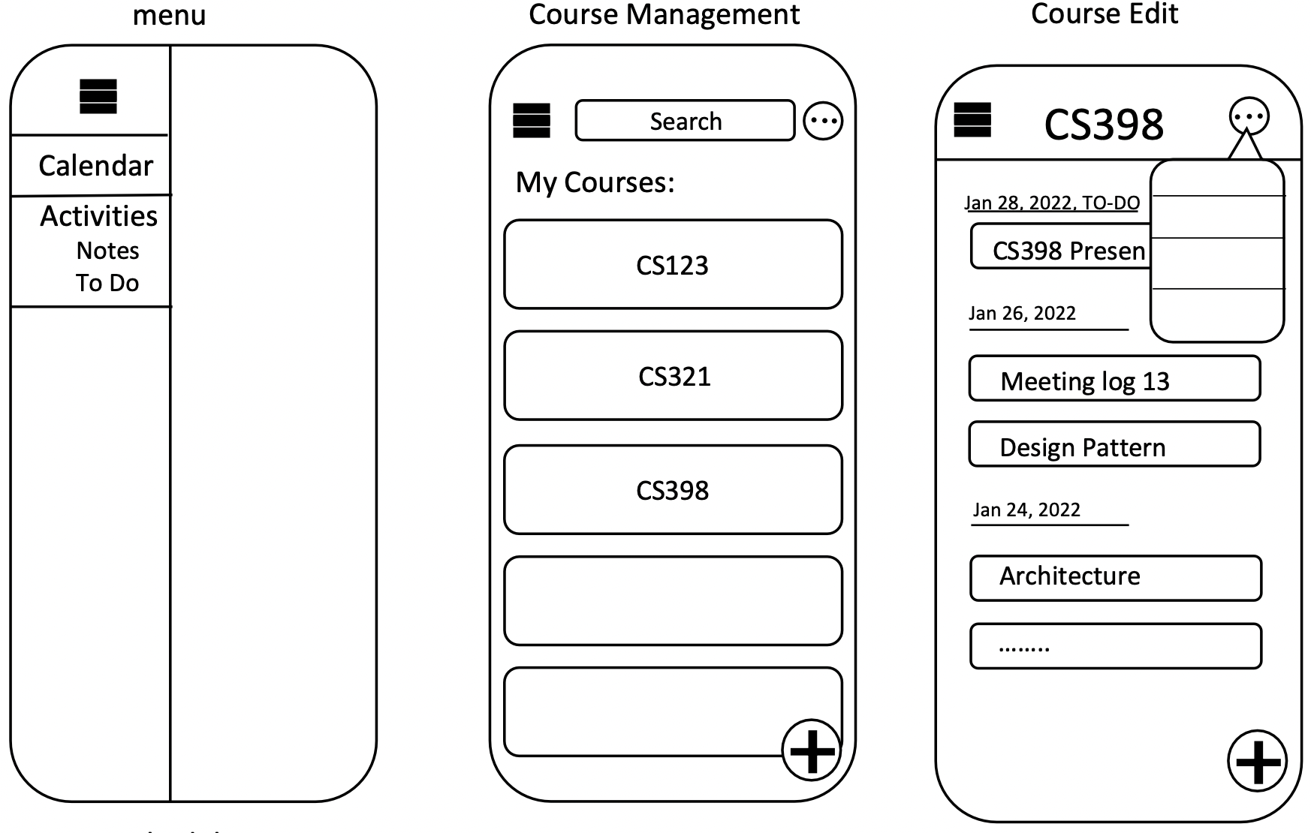
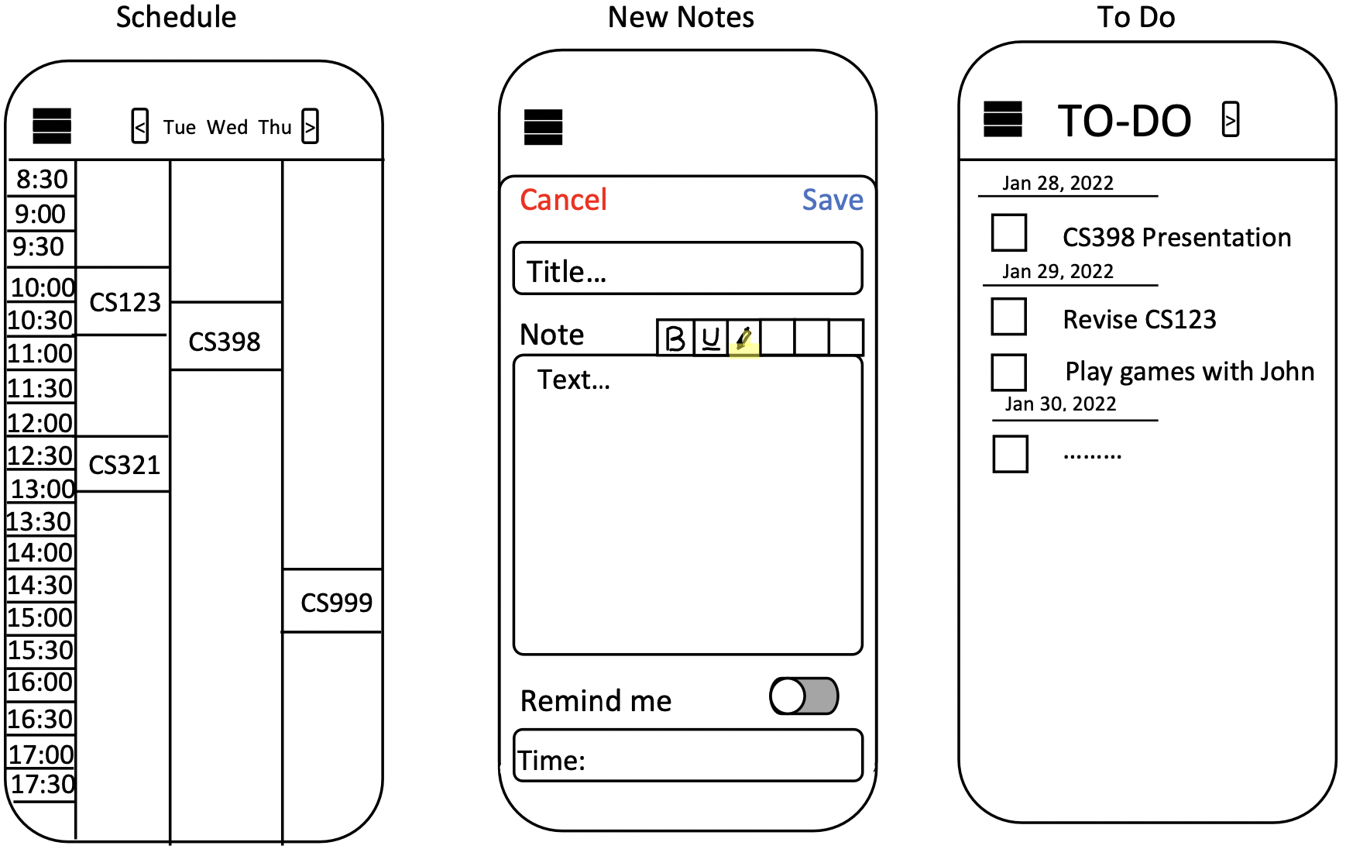
6. UI/UX Design
The UI consists of three main interface
Weekly Schedule
Course management
To do list

Slide 14
7. Design Patterns
Three design patterns in action:
Observer pattern
used to run MVC model fluently
Builder
used to construct calendar items and note objects
Singleton
used to keep consistent model through out the application

